Slide 1
VUE.JS vs. REACT
Comparison and basics for beginners
David Długosz
Notes:
Are your classroom colors different than what you see in this template? That’s OK! Click on Design -> Variants (the down arrow) -> Pick the color scheme that works for you!
Feel free to change any “You will…” and “I will…” statements to ensure they align with your classroom procedures and rules!

Slide 2
Basic info
Vue | React
134,977 ★ on GitHub 270 contributors Latest version 2.6.10 By Evan You (@youyuxi) Alibaba, Nintendo, 9GAG… | 126,629 ★ on GitHub 1,291 contributors Latest version 16.8.6 By Facebook FB, Netflix, Uber, Twitter…
* Data from 09.04.2019

Slide 3
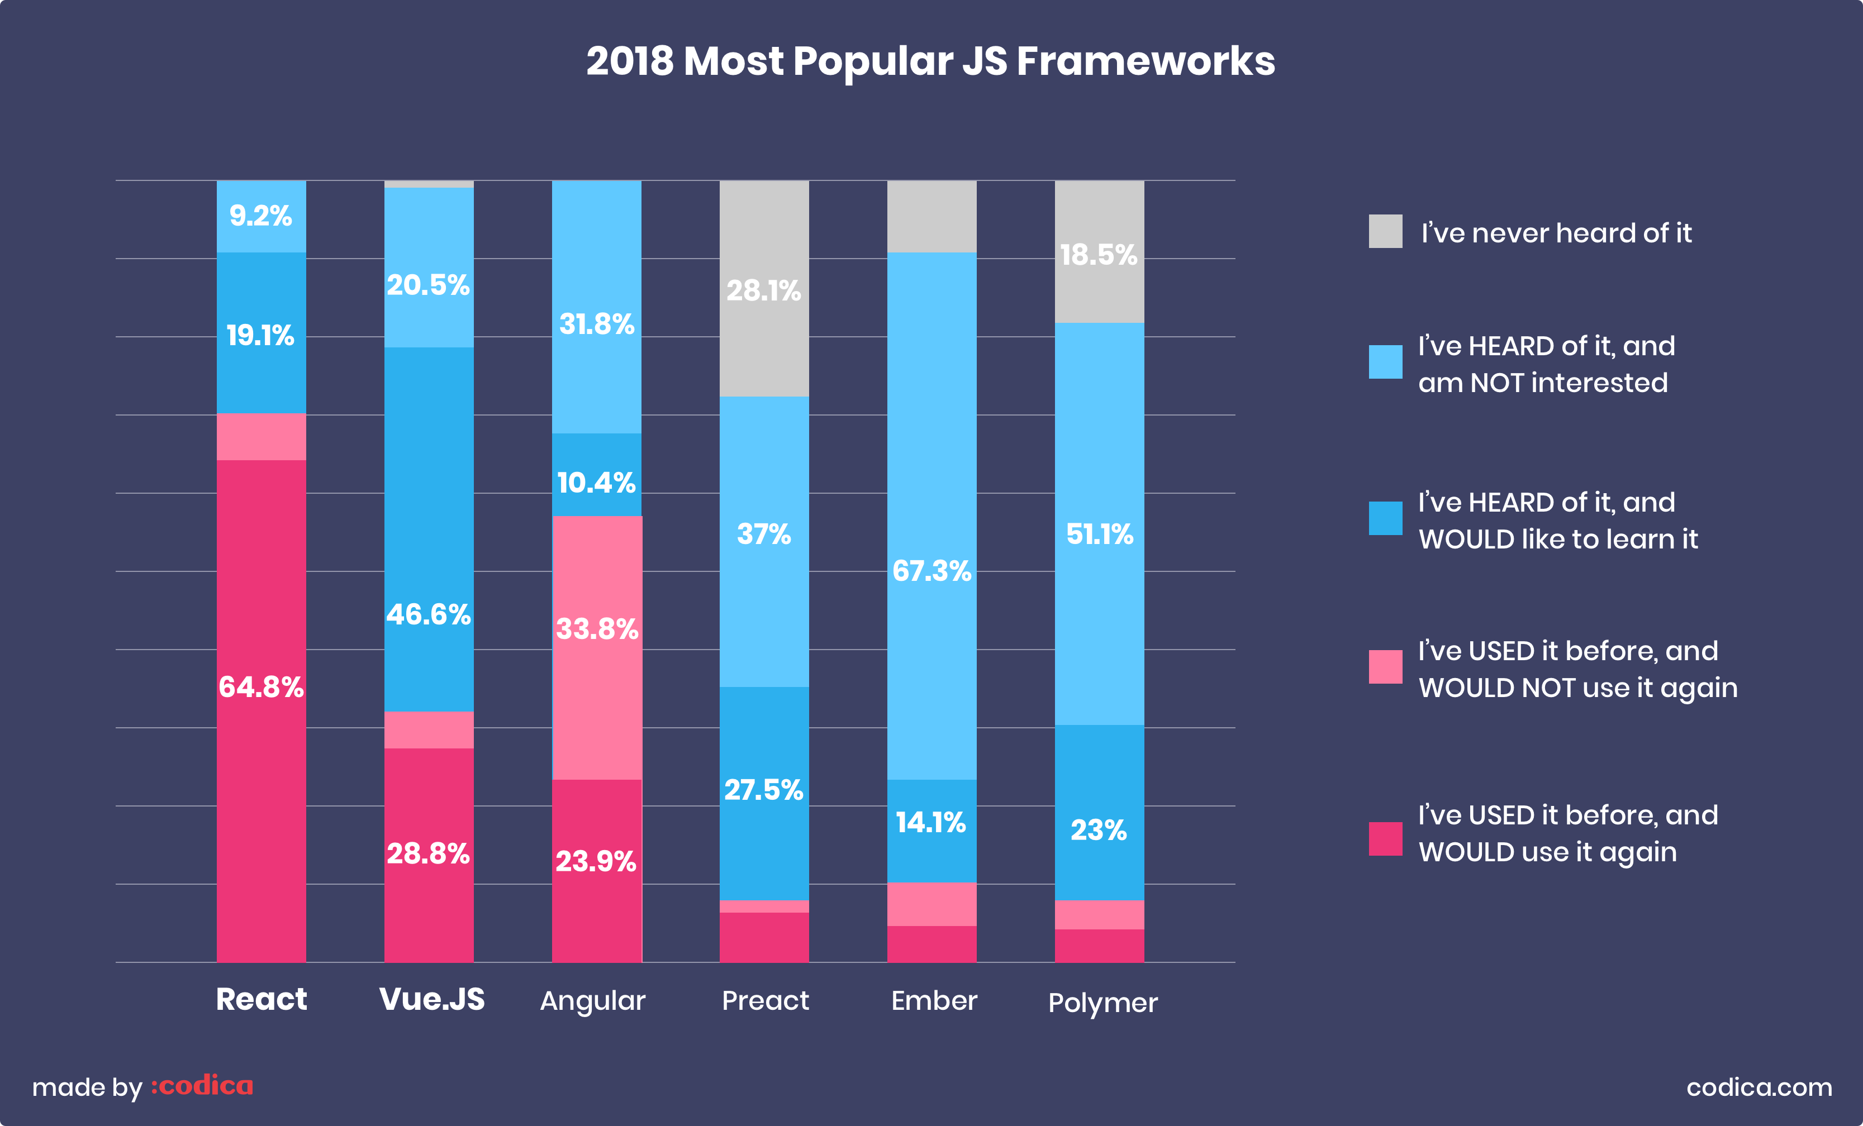

Slide 4
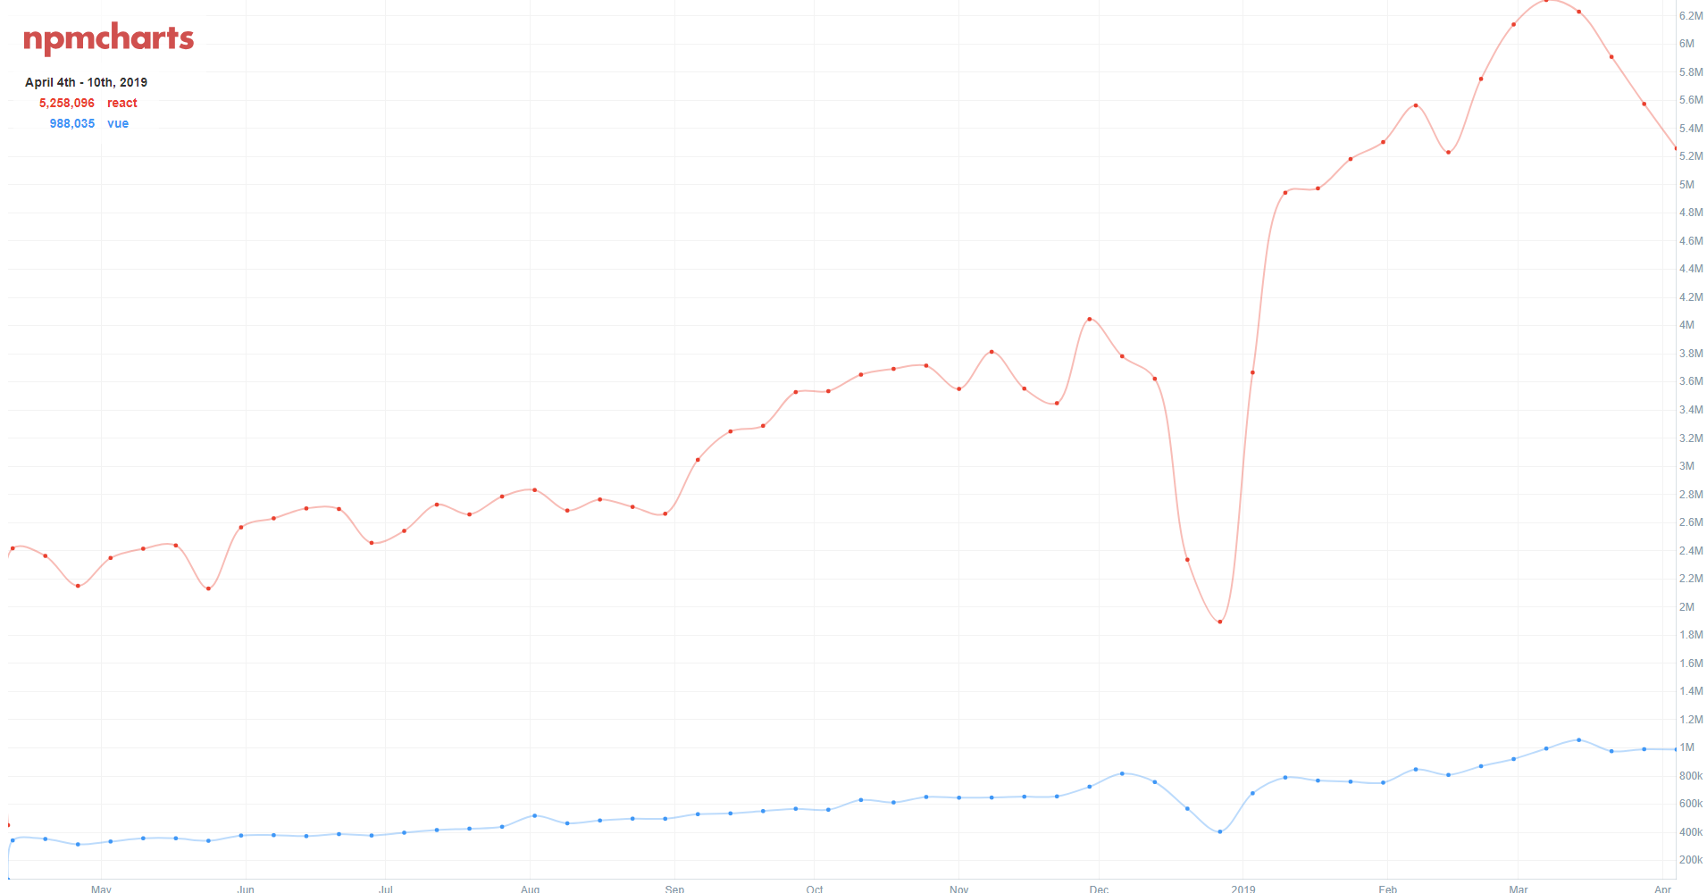
npmcharts

Slide 5
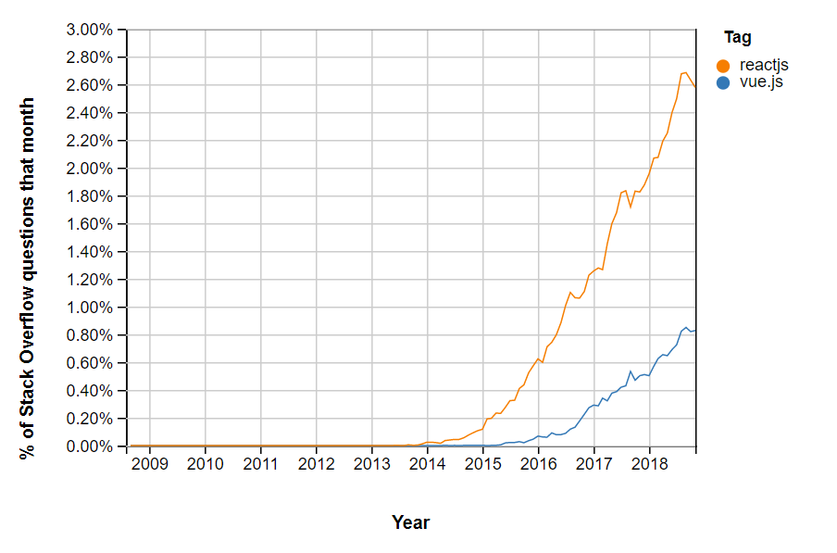
Stack Overflow Trends

Slide 6
Similarities
Virtual DOM
Reactive, composable view components
Core functionality (routing, global state management handled by other libraries)
Support for mobile (React Native, Weex)
MIT License

Slide 7
Components
Building blocks of Vue and React apps
Optional parameters
Returns element describing UI
Lifecycle events
Own data/methods

Slide 8
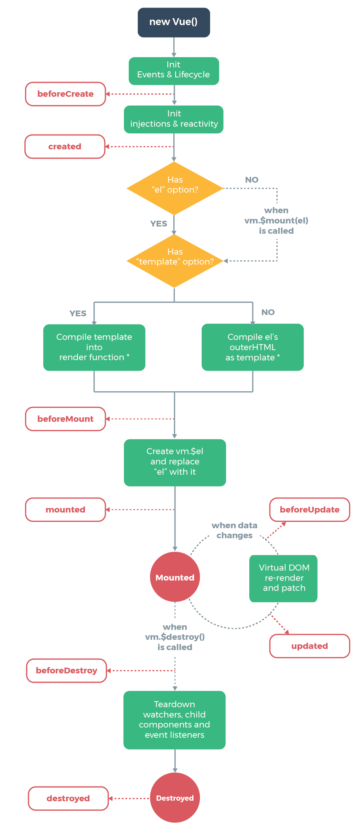
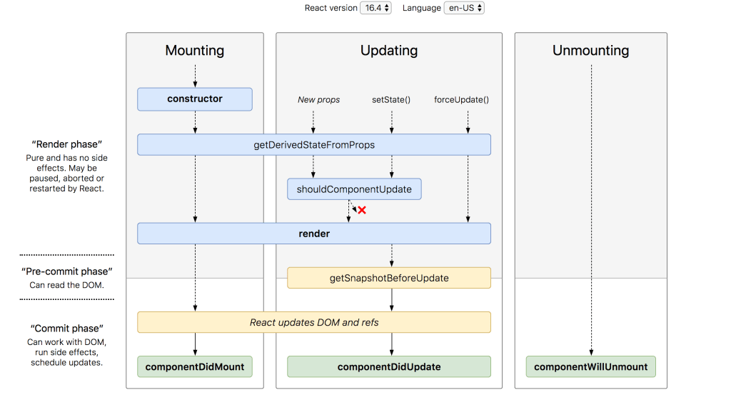
Lifecycles
Vue
React

Slide 9
Differences
Vue | React
Templating Newer (smaller ecosystem) Mutable state in VUEX | JSX Older (bigger ecosystem) Immutable state in REDUX

Slide 10
<template>
…
</template> <script>
export default {
name: 'NewComponent',
…
}; </script> <style> … </style>
Vue
import React, { Component } from 'react';
import './NewComponent.css'; class NewComponent extends Component {
…
render() {
…
}
}
export default NewComponent;
React
NewComponent.jsx/js
…
NewComponent.vue
NewComponent.css

Slide 11
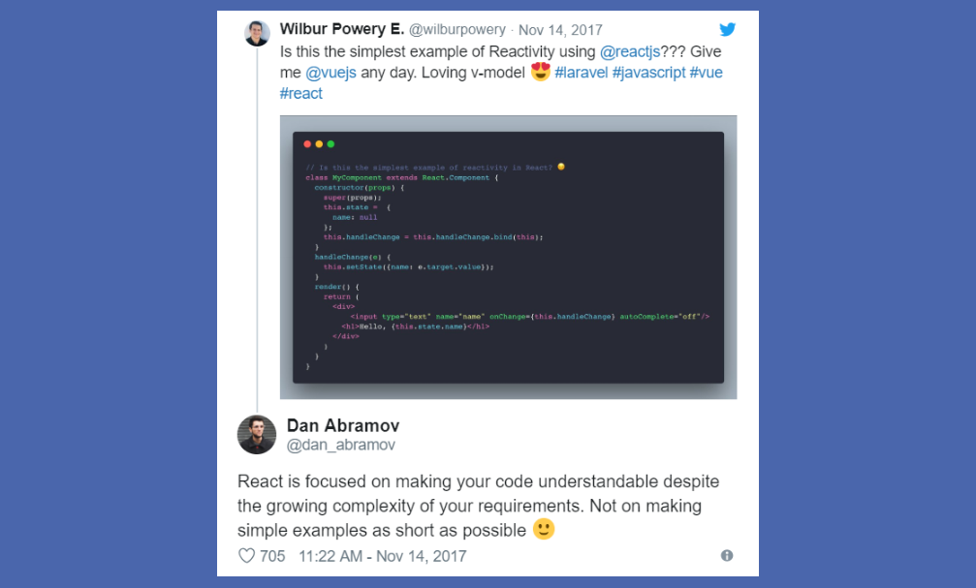

Slide 12
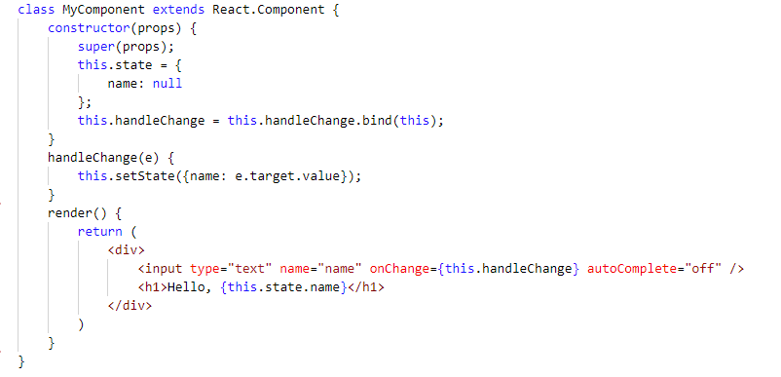
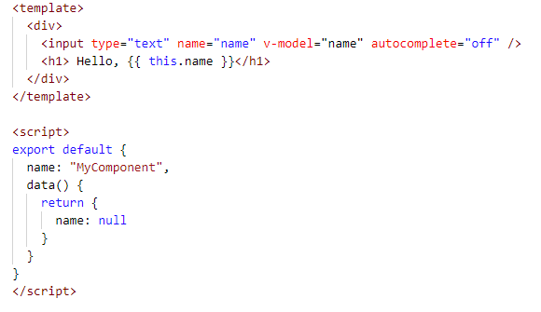
React
Vue

Slide 13
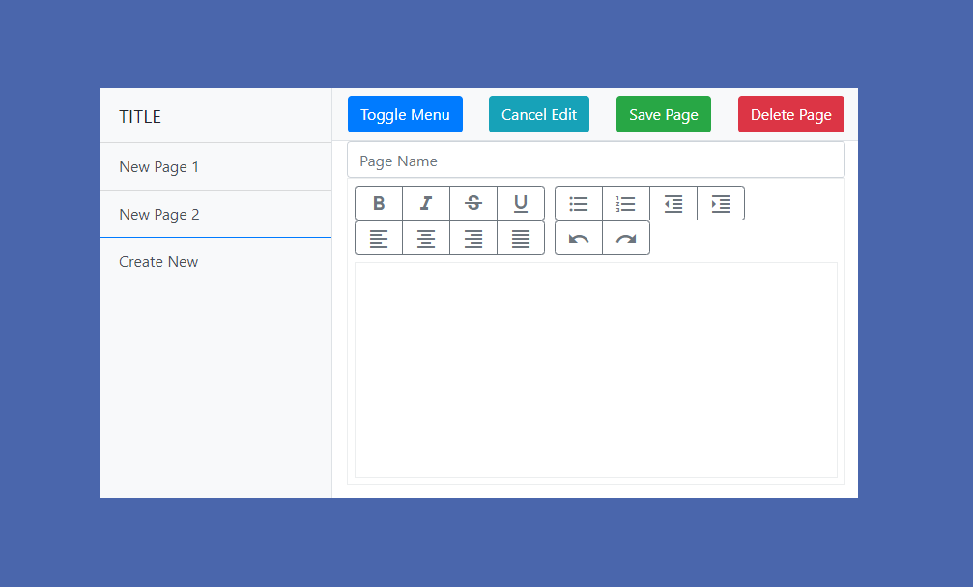
Sample SPA

Slide 14
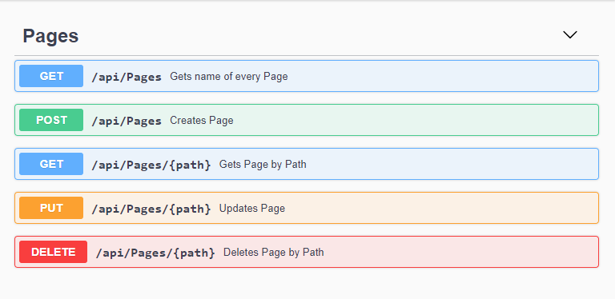
REST API for SPA

Slide 15
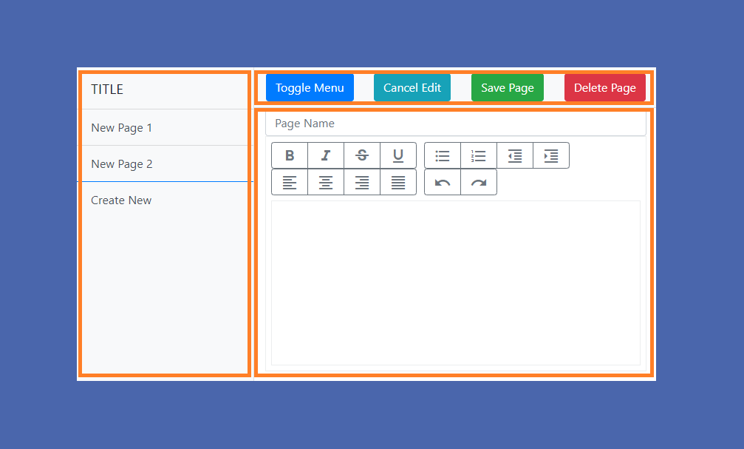
Components of SPA

Slide 16
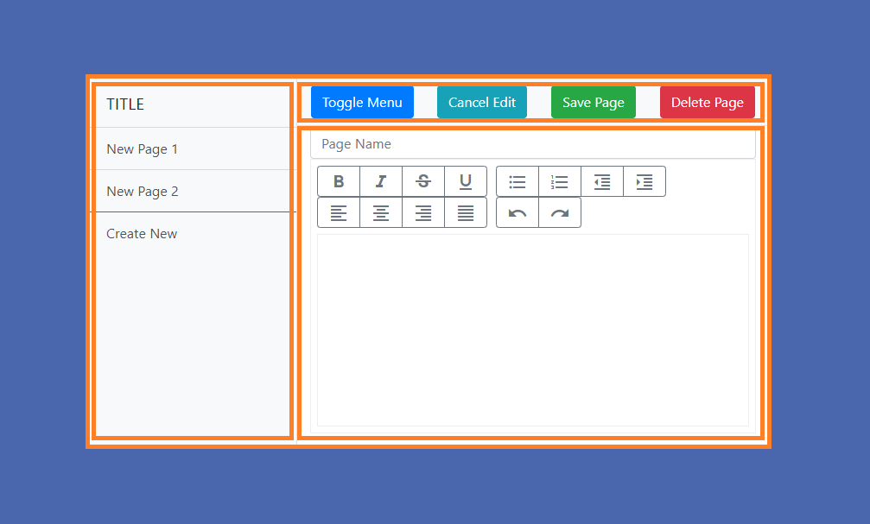
Single components needs to have parent component

Slide 17
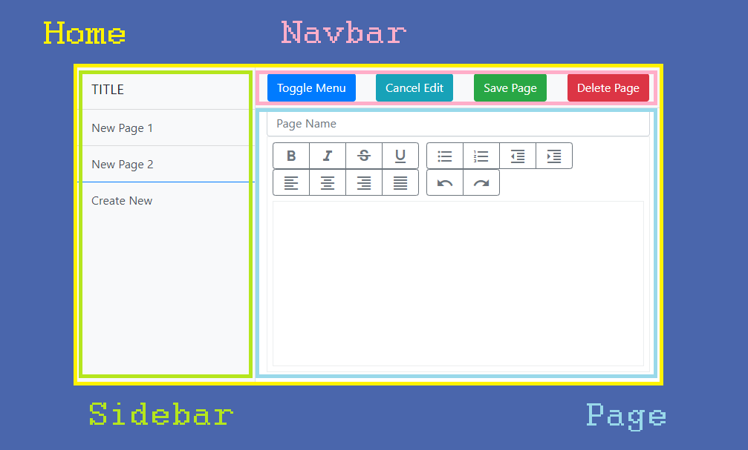

Slide 18
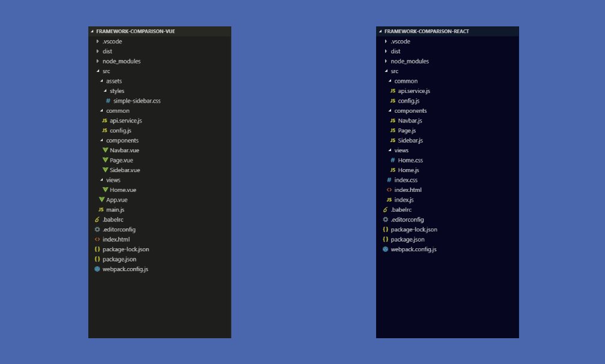
File structure comparison

Slide 19
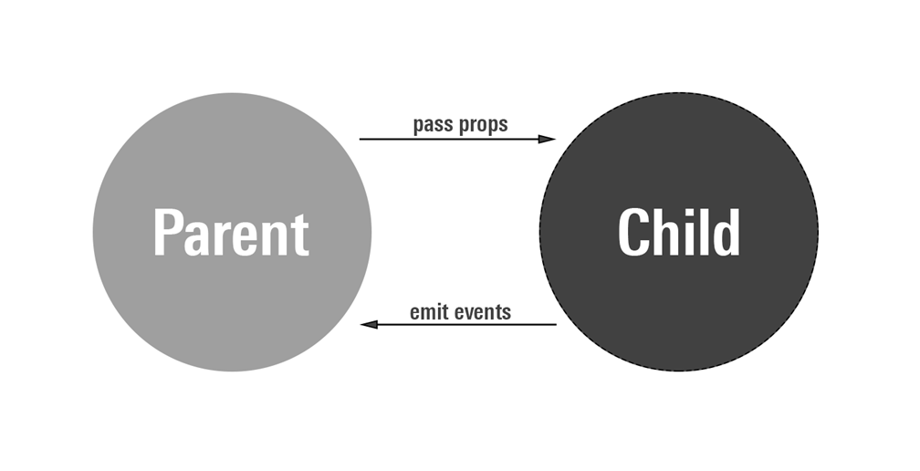
Communication between components

Slide 20
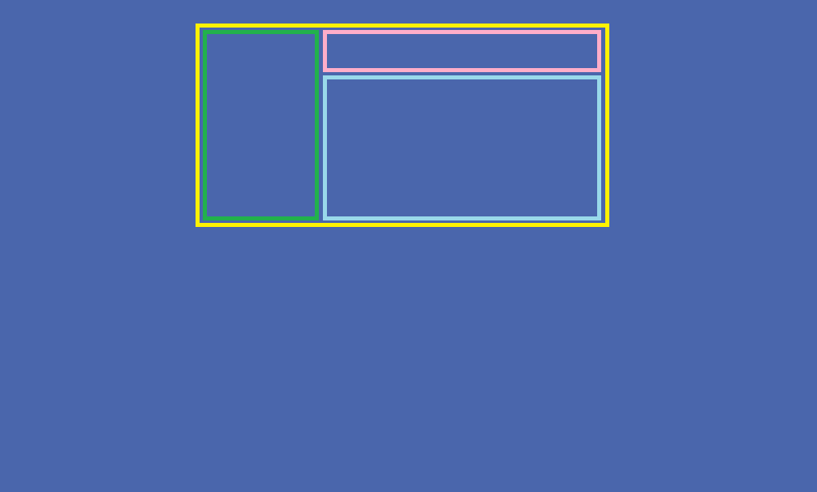
Components layout

Slide 21
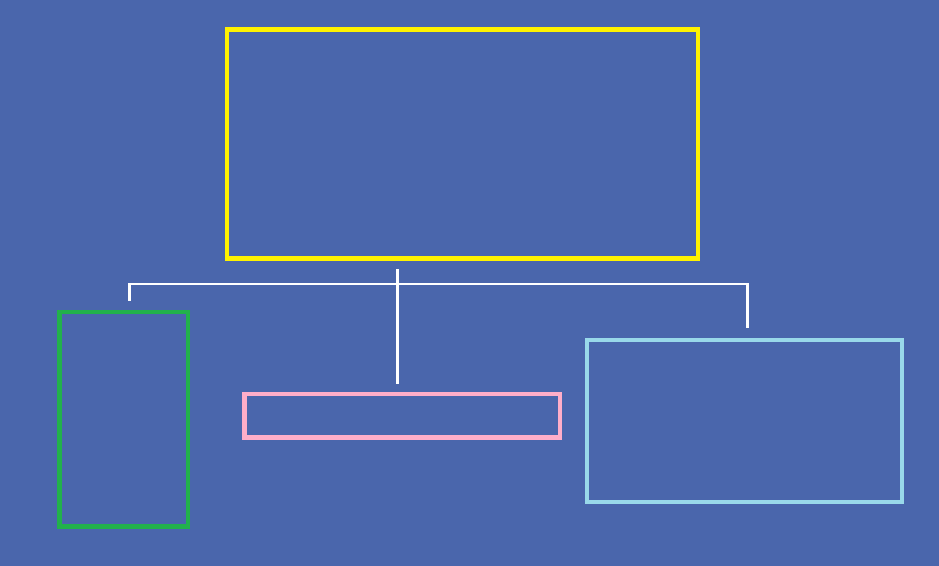
Components hierarchy

Slide 22
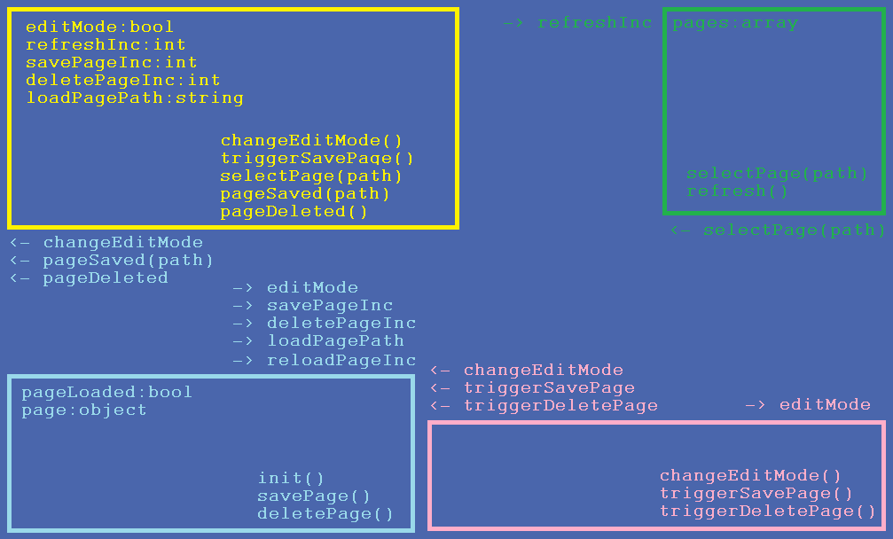

Slide 23
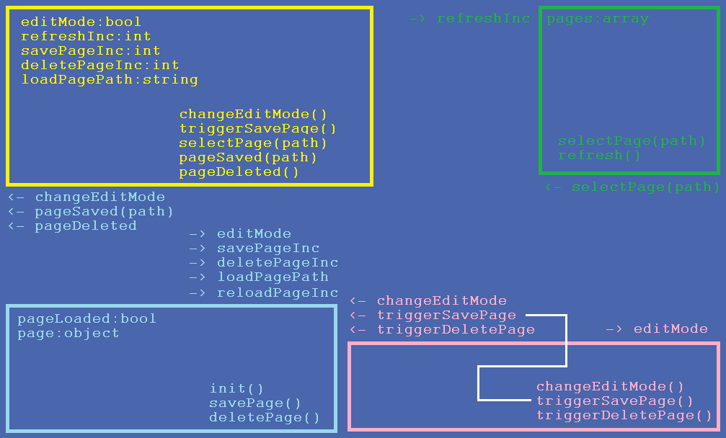

Slide 24
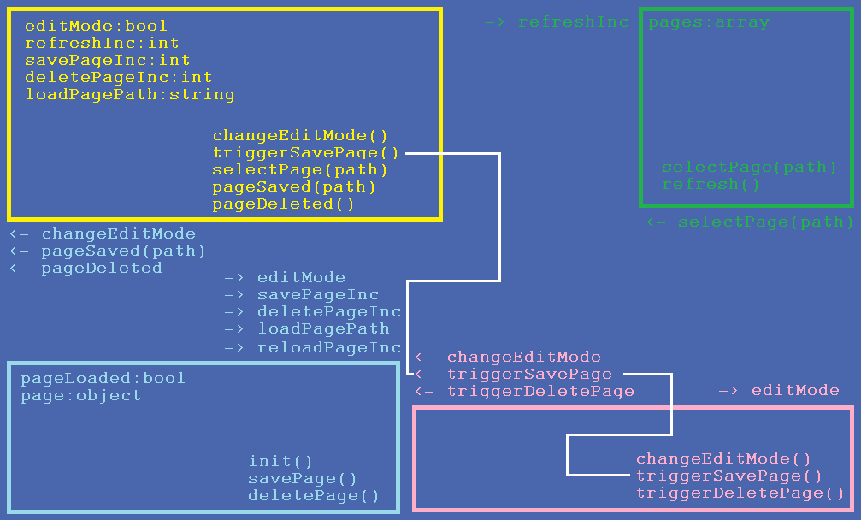

Slide 25
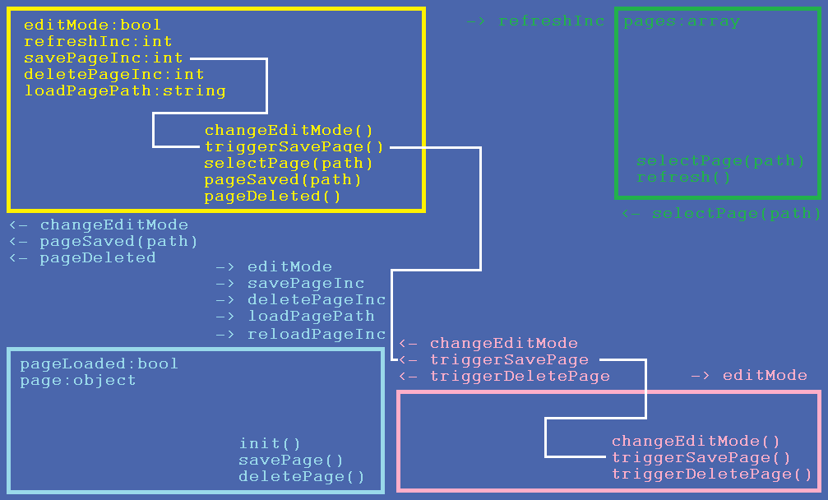

Slide 26
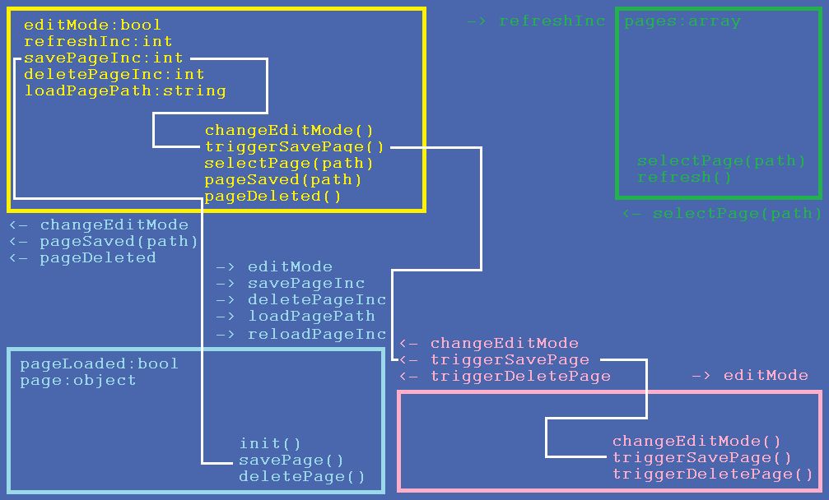

Slide 27
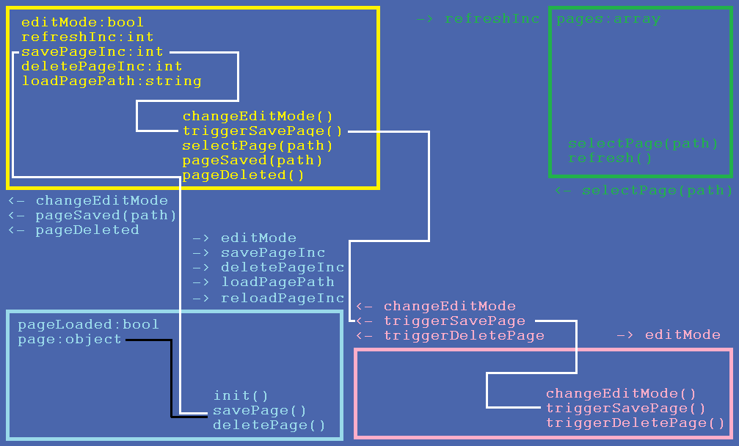

Slide 28
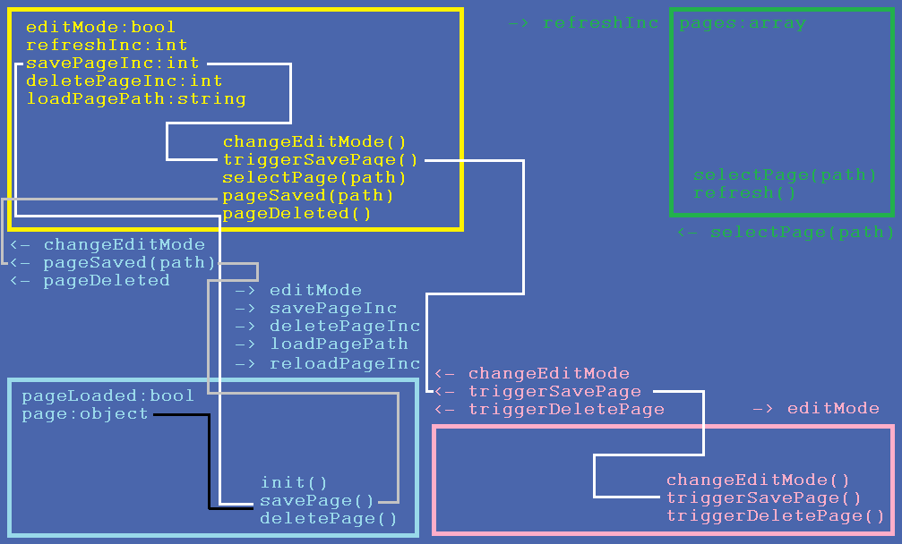

Slide 29
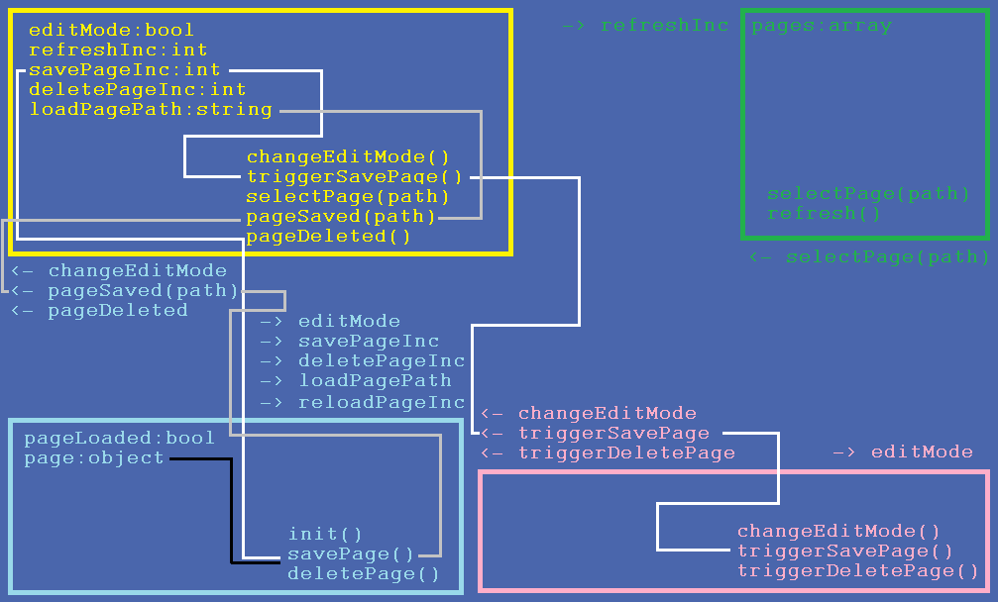

Slide 30
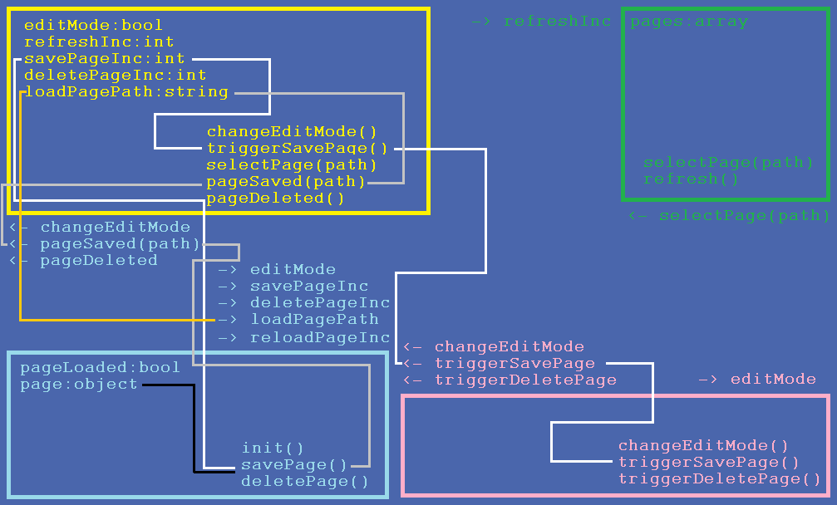

Slide 31
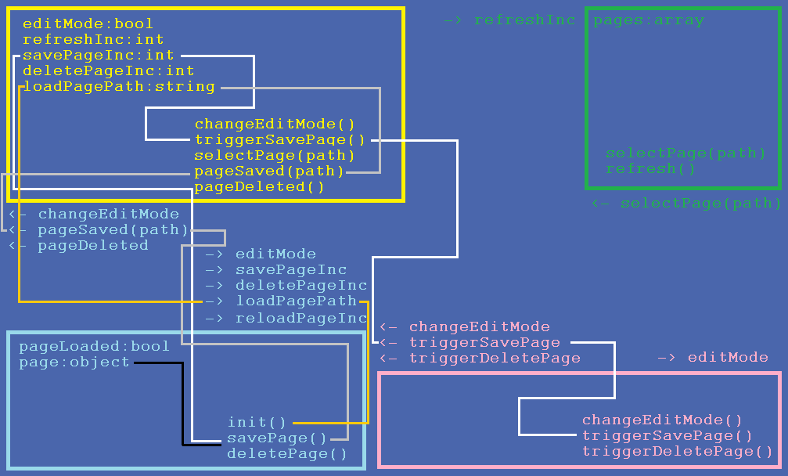

Slide 32
How to avoid this?

Slide 33
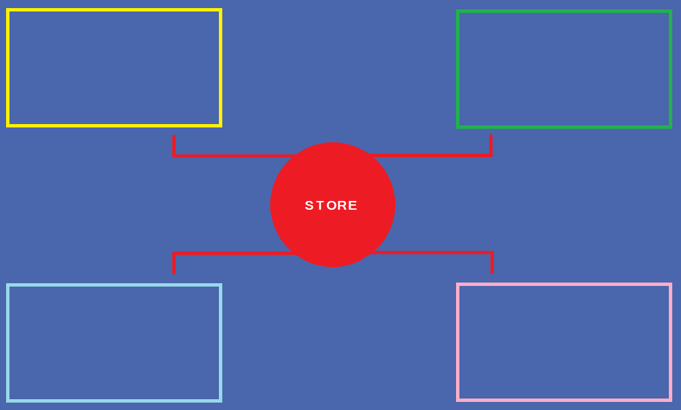

Slide 34
State management
Vue | React
Vuex Actions Mutations | Redux Actions Reducers

Slide 35
Reasons for immutability in Redux
Enforce mutation of state only through reducers
No side effects in reducers
Shallow equality checks
“time-travel debugging”

Slide 36
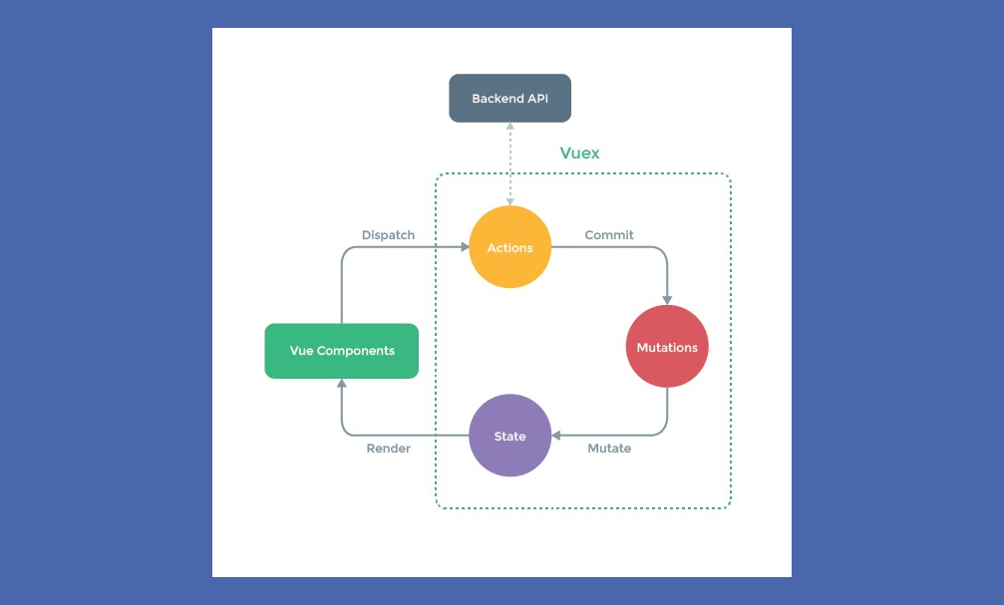
Vuex

Slide 37
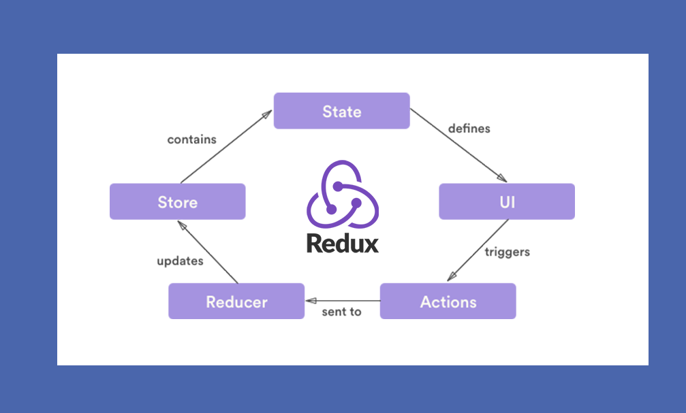
Redux

Slide 38
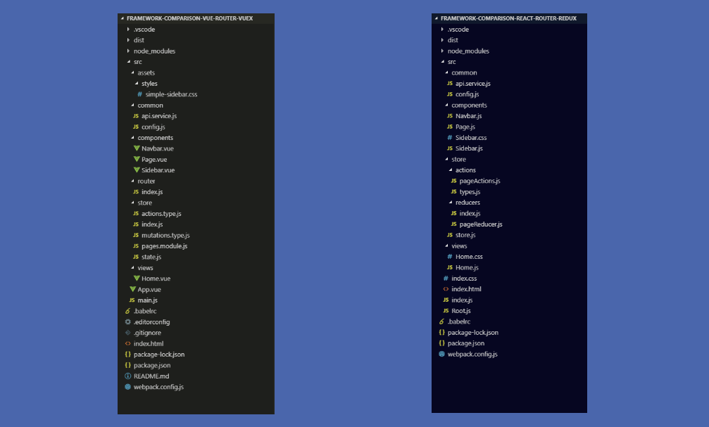
File structure comparison

Slide 39
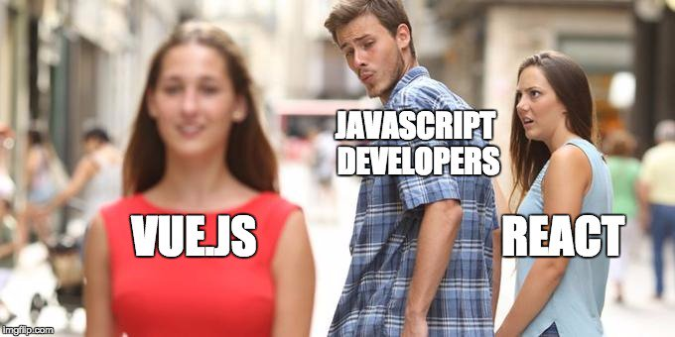

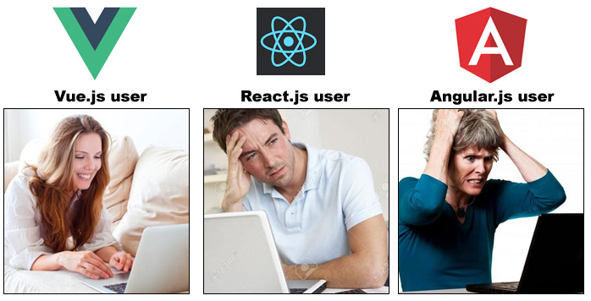
tiny.cc/vuevsreact

